Slide 1
BA 406 Spreadsheet Modeling
Linear Programming:
Spreadsheet Modeling, Applications, and Sensitivity Analysis

Slide 2
Outline
Spread Sheet Modeling
Formulating a Problem in Excel
Solving with Excel Solver
Linear Programming Applications
Resource Allocation Problems
Cost-benefit-tradeoff Problems
Transportation Problems
Assignment Problems
Sensitivity Analysis
Changes in the objective function
Changes in the constraints
Overview

Slide 3
Formulating in Excel
Recall the Wyndor Glass Co. problem
The company decides to produce two new products
A glass door with aluminum framing
Unit profit for doors is $300
A wood-framed glass window
Unit profit for windows is $500
Production Time Used for Each Unit Produced
Plant | Doors | Windows | Availability/week
1 | 1 hour | 0 | 4 hours
2 | 0 | 2 hours | 12 hours
3 | 3 hours | 2 hours | 18 hours

Slide 4
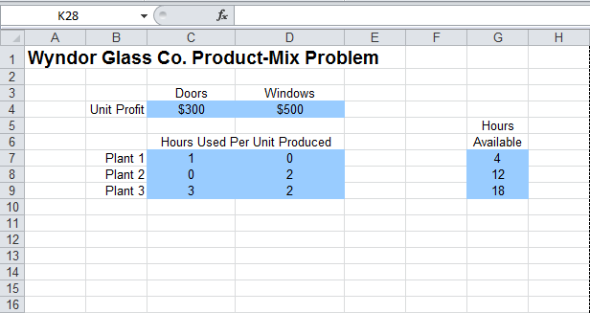
Formulating in Excel
First, put the data you have into Excel

Slide 5
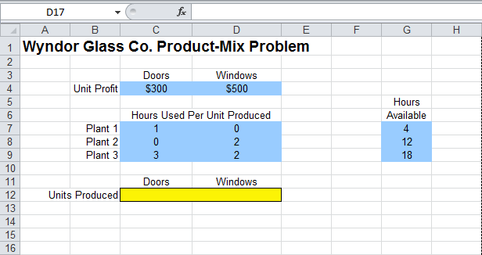
Formulating in Excel
Dedicate cells to your decision variables
D
W

Slide 6
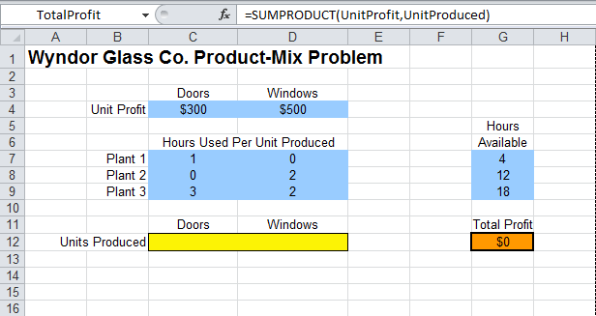
Formulating in Excel
Write your objective function
Total profit =300D+500W

Slide 7
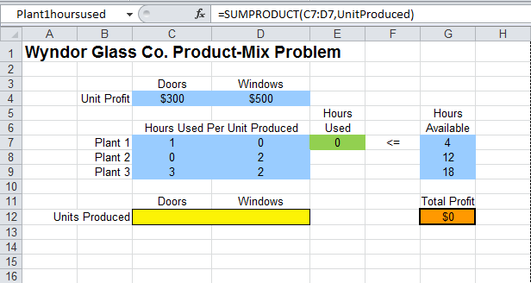
Formulating in Excel
Write your constraints
Hours used in Plant 1 =1D

Slide 8
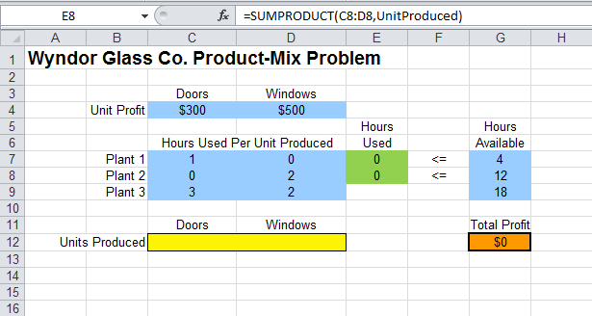
Formulating in Excel
Write your constraints
Hours used in Plant 2 =2W

Slide 9
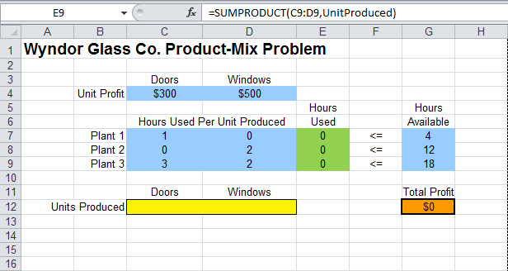
Formulating in Excel
Write your constraints
Hours used in Plant 3 =3D+2W

Slide 10
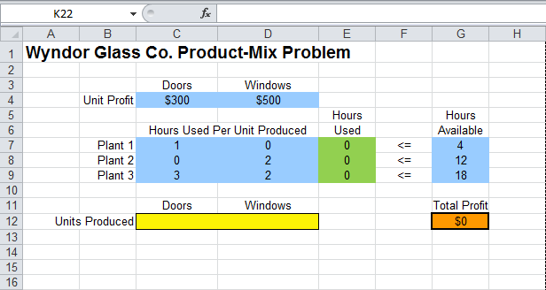
Formulating in Excel
And your spreadsheet model is

Slide 11
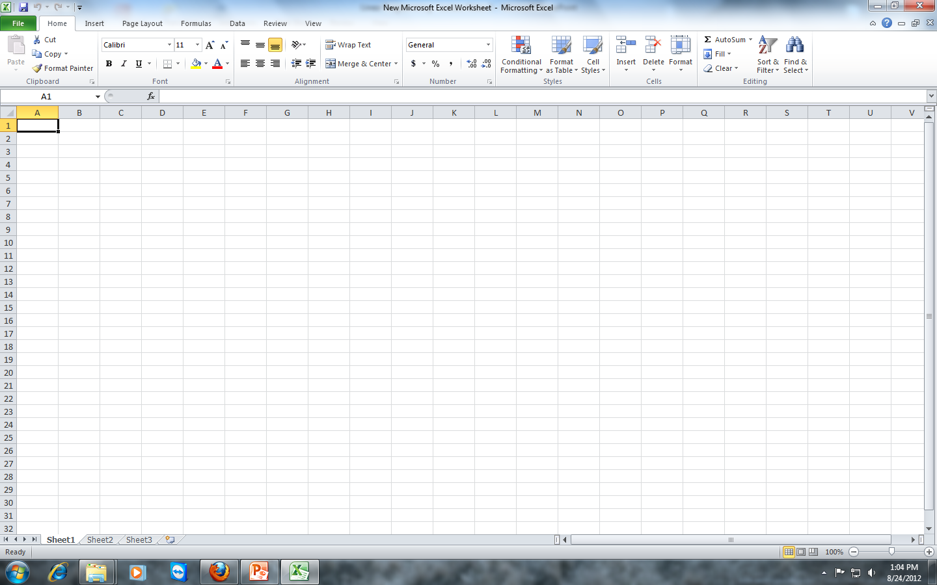
Excel Solver Add-In
First, you need to add Excel Solver
Open an Excel file

Slide 12
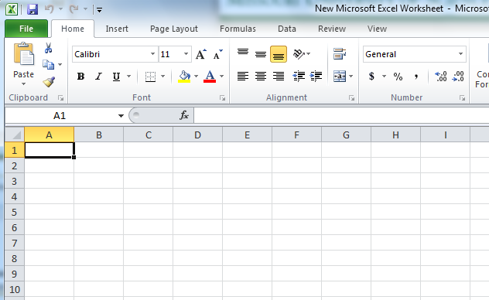
Excel Solver Add-In
Click on File button on left top

Slide 13
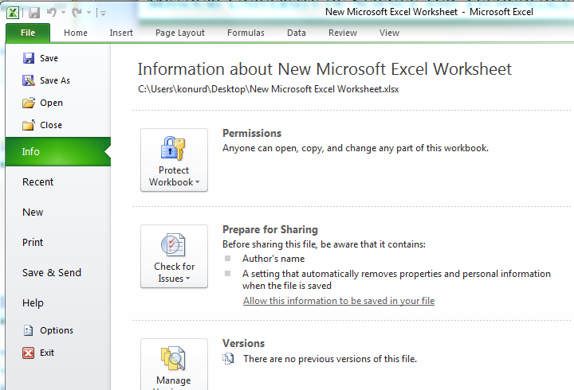
Excel Solver Add-In
Then go to Options and click

Slide 14
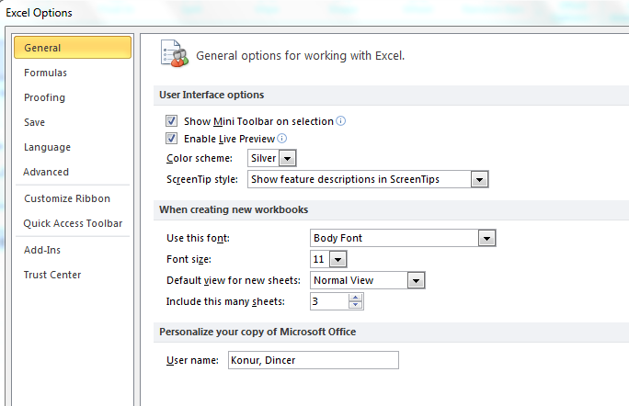
Excel Solver Add-In
A new window will open: go to Add-ins and click

Slide 15
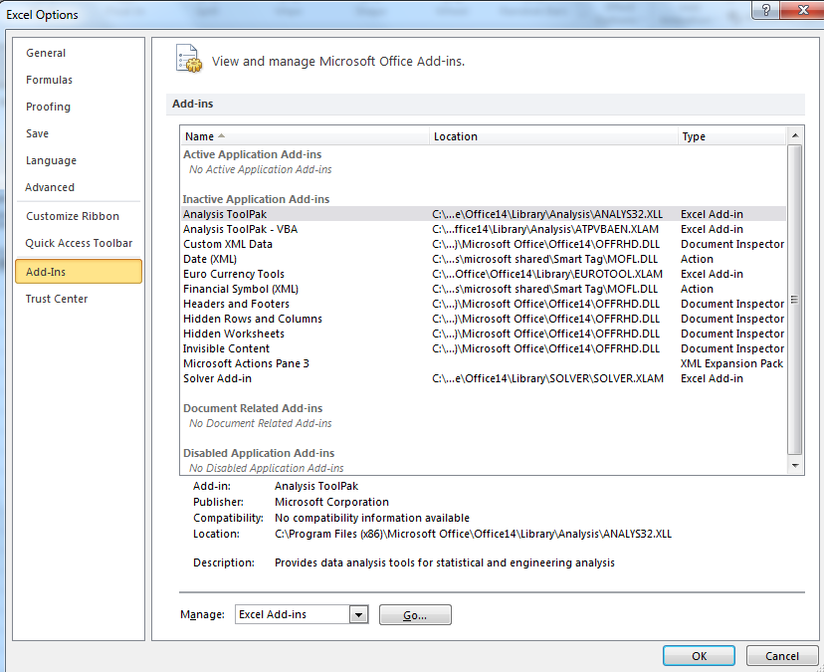
Excel Solver Add-In
A new screen will come up: click Go…

Slide 16
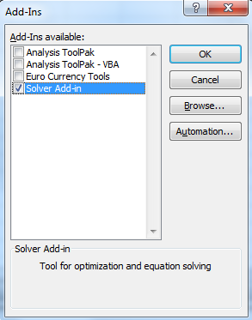
Excel Solver Add-In
A new window will show
Check Solver Add-in
Then click Ok

Slide 17
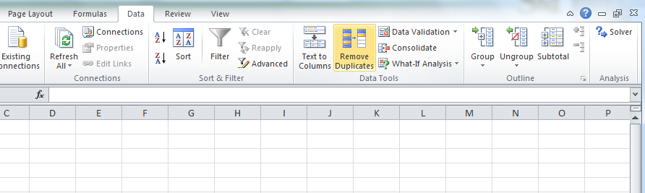
Excel Solver Add-In
Now you have Solver under Data tool

Slide 18
Spreadsheet Modeling
TBA Airlines Problem
TBA Airlines is a small regional company that specializes in short flights in small airplanes.
The company has been doing well and has decided to expand its operations.
The basic issue facing management is whether to purchase more small airplanes to add some new short flights, or start moving into the national market by purchasing some large airplanes, or both.
Question: How many airplanes of each type should be purchased to maximize their total net annual profit?

Slide 19
Spreadsheet Modeling
TBA Airlines
The following data is given
 | Small Airplane | Large Airplane | Capital Available
Net annual profit per airplane | $7 million | $22 million
Purchase cost per airplane | 25 million | 75 million | $250 million
Maximum purchase quantity | 5 | —

Slide 20
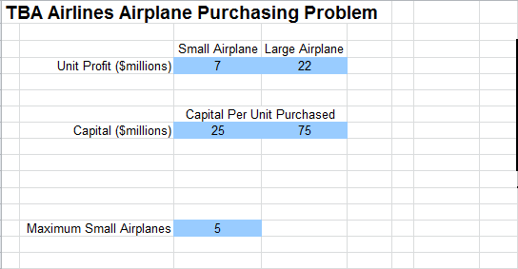

Spreadsheet Modeling
Enter the data…

Slide 21
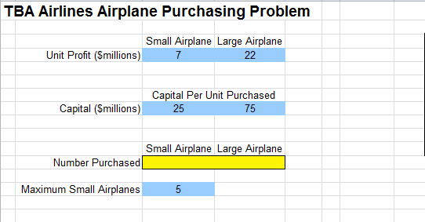
Spreadsheet Modeling
Dedicate cells for your decision variables…

Slide 22
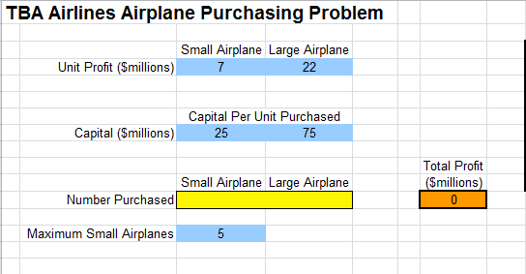
Spreadsheet Modeling
Define the objective function…

Slide 23
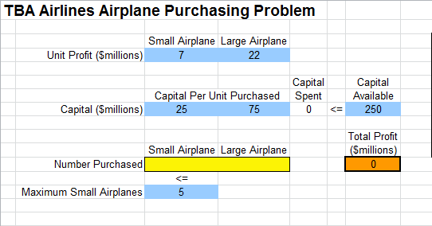
Spreadsheet Modeling
Define the constraints

Slide 24
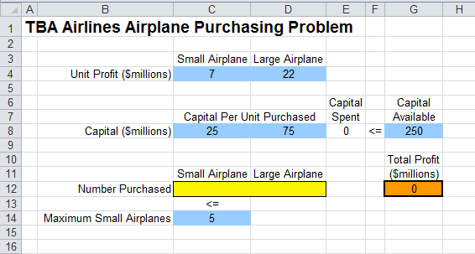
Spreadsheet Modeling
And we have the model on Excel
Let’s solve it…

Slide 25
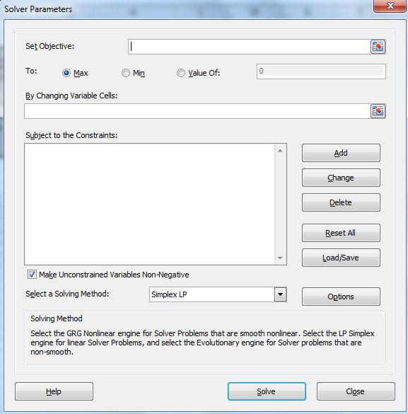
Solving with Excel Solver
Pick the cell where your objective function is defined
Go to Data bar and click on Solver
Pick your objective
Click here to add a constraint..
A new window will pop up
Pick the cells where your decision variables are defined

Slide 26
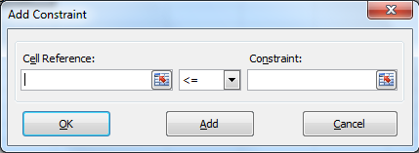
Solving with Excel Solver
Adding a constraint
Enter the cell where left hand side of your constraint is defined
Enter the cell where right hand side of your constraint is defined
Choose the inequality type you have

Slide 27
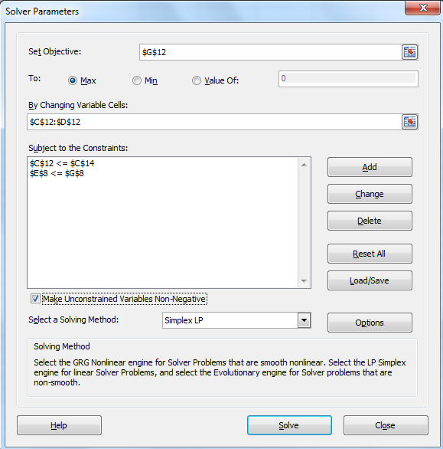
Solving with Excel Solver
Solve the LP
Non-negativity constraints by default
Pick Simplex LP method
Solve it!!!

Slide 28
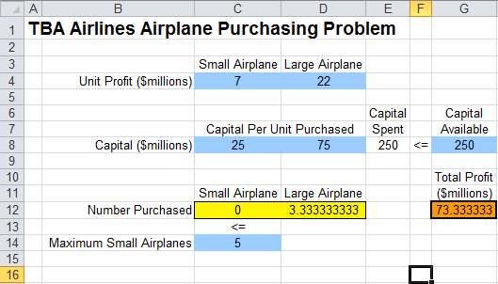
TBA Airlines
The solution is….

Slide 29
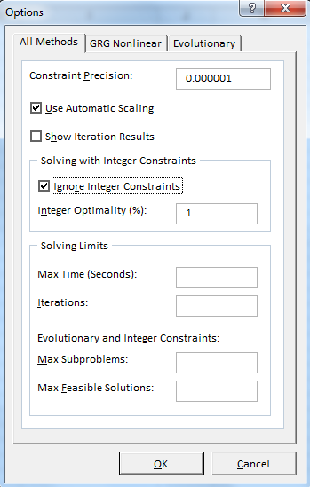
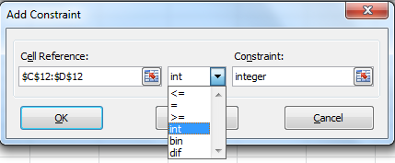
Further with Excel
You can define your decision variables to be integer
Pick your decision variables
Uncheck
Pick int
Click OK

Slide 30
TBA Airlines
The integer solution is….

Slide 31
Outline
Spread Sheet Modeling
Formulating a Problem in Excel
Solving with Excel Solver
Linear Programming Applications
Resource Allocation Problems
Cost-benefit-tradeoff Problems
Transportation Problems
Assignment Problems
Sensitivity Analysis
Changes in the objective function
Changes in the constraints
Overview

Slide 32
Linear Programming Applications
The following cases are to illustrate different type of problems you may have in practice
Do not try to classify your problem before you formulate it
Formulate the problem and then see if it is similar to well-known problems
Why?
Well known problems may have structures that are helpful in solving them efficiently
Example: network optimization problems…

Slide 33
Resource-Allocation Problems
There are a set of activities under consideration with different contributions
There are a set of resources with limited availability
Each activity has a profit (contribution)
Each activity uses a specific amount of each resource
How much of each activity you should choose to maximize your profit?
Surviving in an island example
Wyndor Glass Co. product mix case

Slide 34
Case: Capital Budgeting (Think-Big)
Capital Budgeting Case: Financial planning
Think-Big Development Co. is a major investor in commercial real-estate development projects.
They are considering three large construction projects
Construct a high-rise office building.
Construct a hotel.
Construct a shopping center.
Each project requires each partner to make four investments: a down payment now, and additional capital after one, two, and three years.
Question: At what fraction should Think-Big invest in each of the three projects?

Slide 35
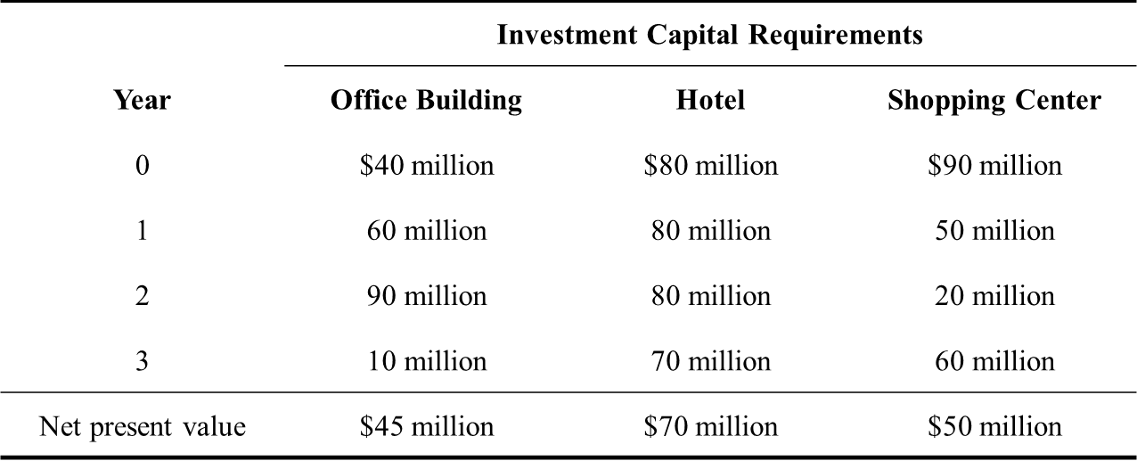
Case: Capital Budgeting
The company currently has $25M and $20M, $20M and $15M will become available after 1, 2, and 3 years, respectively.
Funds that are not used in a year will be available next year
Therefore, we should consider the cumulative availability at the end of each period!!

Slide 36
Case: Capital Budgeting
Cumulative Capital Required
Cumulative
Capital
Available
25
45
65
80
Office |  | Shopping
Building | Hotel | Center
Now | 40 | 80 | 90
End of Year 1 | 100 | 160 | 140
End of Year 2 | 190 | 240 | 160
End of Year 3 | 200 | 310 | 220
 | Office |  | Shopping
 | Building | Hotel | Center
Net Present Value | 45 | 70 | 50
Decision variables:
OB = Participation share in the office building
H = Participation share in the hotel,
SC = Participation share in the shopping center.

Slide 37
Case: Capital Budgeting
The LP model:
Maximize NPV = 45OB + 70H + 50SC subject to 40OB + 80H + 90SC ≤ 25
100OB + 160H + 140SC ≤ 45
190OB + 240H + 160SC ≤ 65
200OB + 310H + 220SC ≤ 80
OB ≥ 0, H ≥ 0, SC ≥ 0.
Net present value
Total invested now
Total invested within 1 year
Total invested within 2 years
Total invested within 3 years
Non-negativity

Slide 38
Case: Capital Budgeting
The Excel formulation and solution

Slide 39
Resource Allocation with Excel
A general template

Slide 40
Cost-benefit-tradeoff Problems
The mix of levels of various activities is chosen to achieve minimum acceptable levels for various benefits at a minimum cost
Min acceptable level for each benefit
Contribution of each activity (decision variable) to the benefit
Cost per unit of each activity
Let’s solve an example ☺

Slide 41
Case: Personnel Scheduling
Union Airways is adding more flights to and from its hub airport and so needs to hire additional customer service agents
The five authorized eight-hour shifts are
Shift 1: 6:00 AM to 2:00 PM
Shift 2: 8:00 AM to 4:00 PM
Shift 3: Noon to 8:00 PM
Shift 4: 4:00 PM to midnight
Shift 5: 10:00 PM to 6:00 AM
Question: How many agents should be assigned to each shift?

Slide 42
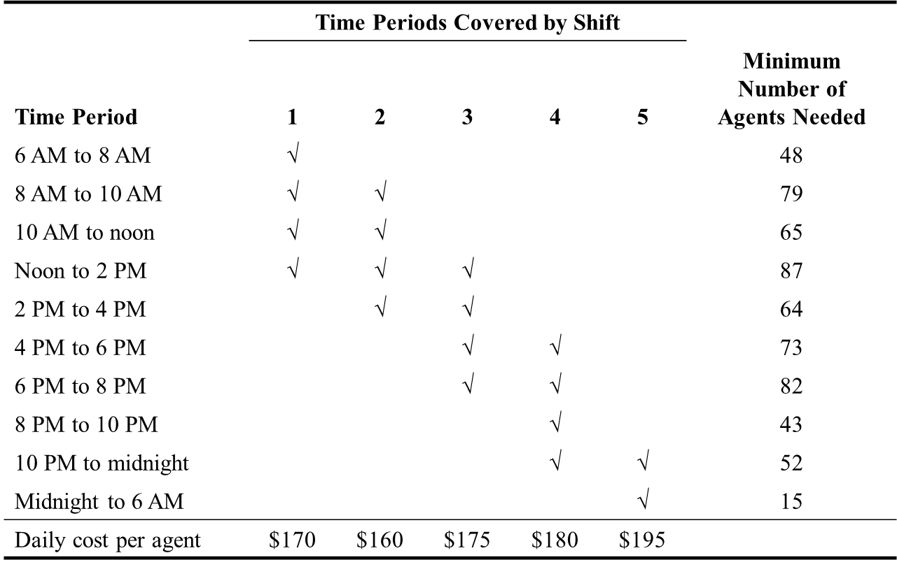
Case: Personnel Scheduling

Slide 43
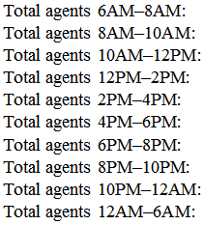
Case: Personnel Scheduling
Decision variables:
S_{i} = Number working shift i (for i = 1 to 5)
Minimize Cost = $170S₁ + $160S₂ + $175S₃ + $180S₄ + $195S₅ subject to S₁ ≥ 48 S₁ + S₂ ≥ 79 S₁ + S₂ ≥ 65 S₁ + S₂ + S₃ ≥ 87 S₂ + S₃ ≥ 64 S₃ + S₄ ≥ 73 S₃ + S₄ ≥ 82 S₄ ≥ 43 S₄ + S₅ ≥ 52 S₅ ≥ 15 S_{i} ≥ 0 (for i = 1 to 5)

Slide 44
Case: Personnel Scheduling
Excel model…

Slide 45
Cost-benefit-tradeoff with Excel
A general template

Slide 46
Transportation Problems
Suppose you are the manager of Wal-Mart in CO
You want to minimize the transportation costs associated with a single product among distributors and stores
There are m distributors
Each distributor has an amount of inventory of the product
There are n stores
Each stores requires an amount of the product
There is a per unit transportation cost from any distributor to any store
What is the shipment plan?

Slide 47
Transportation Problems
Let distributors be indexed by i, i=1,2,…,m
Supply limit of distributor i is Si
Let stores be indexed by j, j=1,2,…,n
Demand at store j is Dj
Cij: unit transportation cost from distributor i to retailer j
Qij: amount shipped from distributor i to retailer j
mn decision variables…

Slide 48
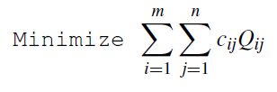


Transportation Problems
Compact formulation:
Minimize total transportation costs
Ship the demand of each store
Distributors have limited supplies

Slide 49
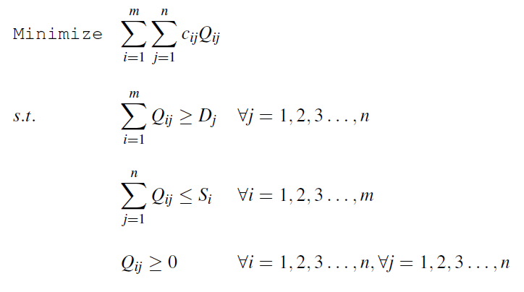
Transportation Problems
And the formulation is….

Slide 50
Case: Big M Company
The Big M Company produces a variety of heavy duty machinery at two factories.
One of its products is a large turret lathe.
Orders have been received from three customers for the turret lathe.
Question: How many lathes should be shipped from each factory to each customer?

Slide 51
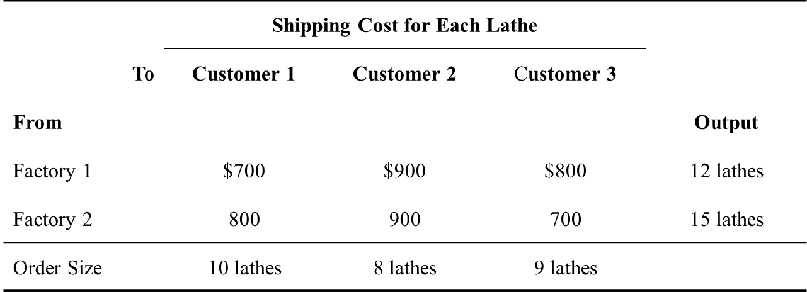
Case: Big M Company
Decision variables:
S_{ij} = Number of lathes to ship from i to j

Slide 52
Case: Big M Company
Minimize Cost = $700S_{F1-C1} + $900S_{F1-C2} + $800S_{F1-C3} + $800S_{F2-C1} + $900S_{F2-C2} + $700S_{F2-C3} subject to Factory 1: S_{F1-C1} + S_{F1-C2} + S_{F1-C3} = 12 Factory 2: S_{F2-C1} + S_{F2-C2} + S_{F2-C3} = 15 Customer 1: S_{F1-C1} + S_{F2-C1} = 10 Customer 2: S_{F1-C2} + S_{F2-C2} = 8 Customer 3: S_{F1-C3} + S_{F2-C3} = 9

Slide 53
Case: Big M Company
Big M Company on Excel

Slide 54
Assignment Problems
Includes assignment decisions
Assignment of people to shifts
Assignment of jobs to machines
Assignment of classes to courses
Project assignments that I will make!!!

Slide 55
Case: Sellmore Company
The marketing manager of Sellmore Company will be holding the company’s annual sales conference soon.
He is hiring four temporary employees:
Ann
Ian
Joan
Sean
Each will handle one of the following four tasks:
Word processing of written presentations
Computer graphics for both oral and written presentations
Preparation of conference packets, including copying and organizing materials
Handling of advance and on-site registration for the conference
Question: Which person should be assigned to which task?

Slide 56
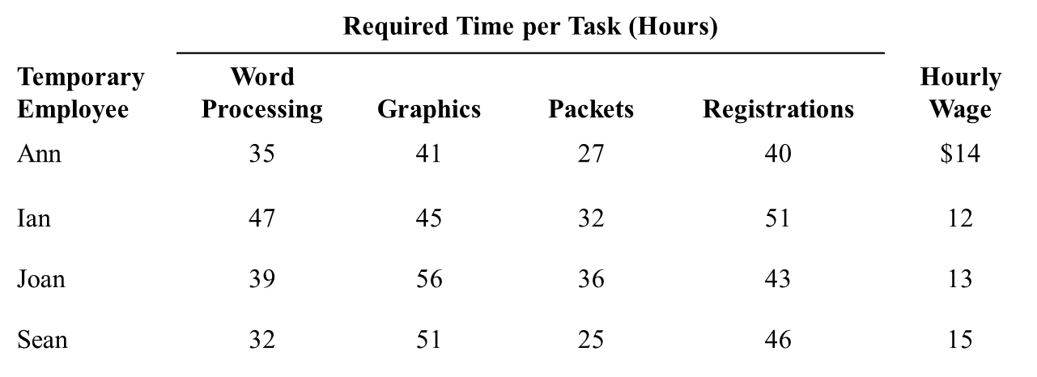
Case: Sellmore Company
Formulate the LP

Slide 57
Case: Sellmore Company
This is an integer (binary) programming problem. We will learn more about integer programming

Slide 58
Assignment Problems
Given a set of tasks to be performed and a set of assignees who are available to perform these tasks, the problem is to determine which assignee should be assigned to each task.
To fit the model for an assignment problem, the following assumptions need to be satisfied:
The number of assignees and the number of tasks are the same.
Each assignee is to be assigned to exactly one task.
Each task is to be performed by exactly one assignee.
There is a cost associated with each combination of an assignee performing a task.
The objective is to determine how all the assignments should be made to minimize the total cost.

Slide 59
Mixed Problems
Types of functional constraints
Type | Form* | Typical Interpretation | Main Usage
Resource constraint | LHS ≤ RHS | For some resource, Amount used ≤ Amount available | Resource-allocation problems and mixed problems
Benefit constraint | LHS ≥ RHS | For some benefit, Level achieved ≥ Minimum Acceptable | Cost-benefit-trade-off problems and mixed problems
Fixed-requirement constraint | LHS = RHS | For some quantity, Amount provided = Required amount | Transportation problems and mixed problems
* LHS = Left-hand side (a SUMPRODUCT function). RHS = Right-hand side (a constant).

Slide 60
Outline
Spread Sheet Modeling
Formulating a Problem in Excel
Solving with Excel Solver
Linear Programming Applications
Resource Allocation Problems
Cost-benefit-tradeoff Problems
Transportation Problems
Assignment Problems
Sensitivity Analysis
Changes in the objective function
Changes in the constraints
Overview

Slide 61
Changes in The Objective Function
Let’s consider the Wyndor Glass Co. problem
What if profit for doors was not $300?
$100, $200, $300…

Slide 62
Change in One Coefficient
$200 per door, no change in the optimal solution
$500 per door, no change in the optimal solution
$1,000 per door, change in the optimal solution

Slide 63
Change in One Coefficient
→ Risk Solver Platform of the textbook

Slide 64
Change in One Coefficient
Using the sensitivity analysis
So that your optimal solution will not change
How much you can increase
How much you can decrease

Slide 65
Change in One Coefficient

Slide 66
Changes in Multiple Coefficients
→ Risk Solver Platform of the textbook
Total Profit:
Doors Produced: Windows Produced:

Slide 67
Changes in Multiple Coefficients
100 Percent Rule
If simultaneous changes are made in the coefficients of the objective function, calculate for each change the percentage of the allowable change (increase or decrease) for that coefficient to remain within its allowable range. If the sum of the percentage changes does not exceed 100 percent, the original optimal solution definitely will still be optimal. (If the sum does exceed 100 percent, then we cannot be sure.)

Slide 68
100 Percent Rule
Profit for each door: 300→500 (increase)
Percentage of allowable increase=100%(500-300)/450
44.44%
Profit for each window: $500→$400 (decrease)
Percentage of allowable decrease=100%(500-400)/300
33.33%
Total = 44.44%+33.33%=77.77% < 100%
No change in the optimum solution

Slide 69
Changes in The Constraints
Let’s consider the Wyndor Glass Co. problem
What if profit plant 2 has more hours available?
13, 14, 15…

Slide 70
Change in One Constraint
From 12→13
1 more hour at Plant 2, $150 increase in weekly profit
From 13→18
5 more hours at Plant 2, $750 increase in weekly profit, $150 for each hour
From 18→20
2 more hours at Plant 2, no change in weekly profit

Slide 71
Change in One Constraint
Using the sensitivity analysis
So that your shadow price will not change
How much you can increase
How much you can decrease

Slide 72
Change in One Constraint
Shadow price: Given an optimal solution and the corresponding value of the objective function for a linear programming model, the shadow price for a functional constraint is the rate at which the value of the objective function changes by 1 unit change on the right-hand-side

Slide 73
Change in One Constraint
Increasing capacity of plant 2 by 1 hour increases the profit by 150
Would you pay $100 to have 1 more hour in plant 2?
Would you pay $200 to have 1 more hour in plant 2?

Slide 74
Changes in Multiple Constraints
100 Percent Rule
The shadow prices remain valid for predicting the effect of simultaneously changing the right-hand sides of some of the functional constraints as long as the changes are not too large. To check whether the changes are small enough, calculate for each change the percentage of the allowable change (decrease or increase) for that right-hand side to remain within its allowable range. If the sum of the percentage changes does not exceed 100 percent, the shadow prices definitely will still be valid. (If the sum does exceed 100 percent, then we cannot be sure.)

Slide 75
Outline
Spread Sheet Modeling
Formulating a Problem in Excel
Solving with Excel Solver
Linear Programming Applications
Resource Allocation Problems
Cost-benefit-tradeoff Problems
Transportation Problems
Assignment Problems
Sensitivity Analysis
Changes in the objective function
Changes in the constraints
Overview

Slide 76
Overview
Formulating a problem
Understand the problem and the data
Define the decision variables
Define the objective and objective functions
Define the constraints
Combine objective, objective function, and constraints

Slide 77
Overview
Graphical solution
For linear models with 2 decision variables
Let the decision variables be the axes of the graph
Draw the lines for the constraints
Assume “=“ for the constraint and draw the line
Find the region defined by each constraint
Pick a point and see if it satisfies the constraint
Find the feasible region
Draw iso-lines or evaluate the corner points

Slide 78
Overview
Some characteristics of LP models
Unique optimal solution
Alternative optima
Infeasibility
Unboundedness
If there is an optimal solution to an LP, then there is at least one corner solution (these are referred to extreme points as well) that is optimal
Simplex Method uses this fact
LP models are polynomially solvable

Slide 79
Overview
Spreadsheet modeling
Understand the problem and the data
Put the data into the spreadsheet
Dedicate cells to your decision variables
Formulate the objective function
Make sure that right cells are referred with right functions
Formulate the constraints
Make sure right cells are referred with right functions
Use Excel Solver to solve the problem

Slide 80
Overview
Applications of Linear Programming
Resource allocation problems
Cost-benefit-tradeoff problems
Transportation problems
No need to classify before hand
First formulate the problem then see if it is one of the problems

Slide 81
Overview
Basic sensitivity analysis using sensitivity report
Changes in the objective function
Change in one coefficient
Change in multiple coefficients
100 percent rule
Changes in the constraints
Change in one constraint
Change in multiple constraints
100 percent rule

Slide 82
Learning Objectives
Mathematical formulation of LPs
Mathematical formulation of LPs
Mathematical formulation of LPs
Mathematical formulation of LPs
Graphical solution of 2-decision variables LPs
Spreadsheet modeling and using Excel Solver
Spreadsheet modeling and using Excel Solver
Basic properties of LPs

Slide 83
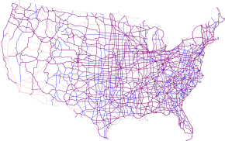
Next time…
Network Optimization

Slide 84
Outline
Spread Sheet Modeling
Formulating a Problem in Excel
Solving with Excel Solver
Linear Programming Applications
Resource Allocation Problems
Cost-benefit-tradeoff Problems
Transportation Problems
Assignment Problems
Sensitivity Analysis
Changes in the objective function
Changes in the constraints
Overview

